Slide 2
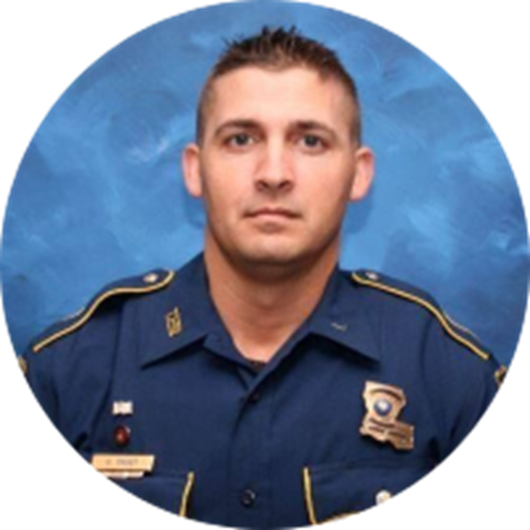
Why was L36 A Warrior’s
Way established?
LA State Trooper George B. Baker
EOW 5/24/2020
Call number: L36
A warrior in everything he did!

Slide 3
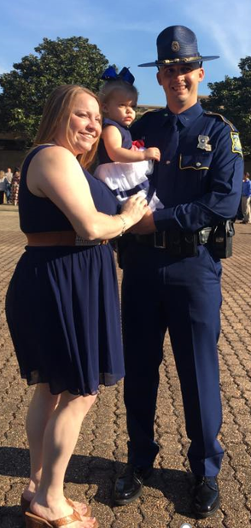
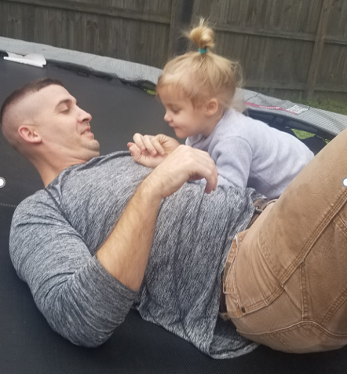
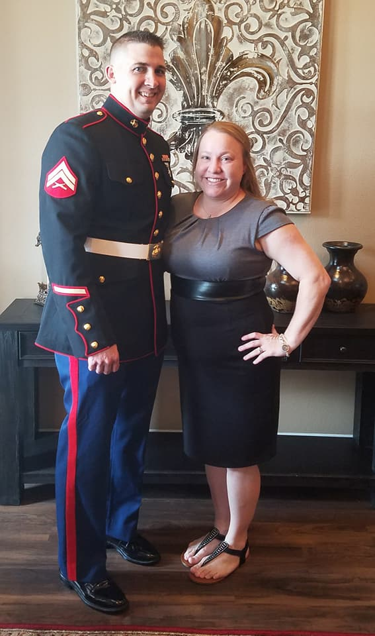
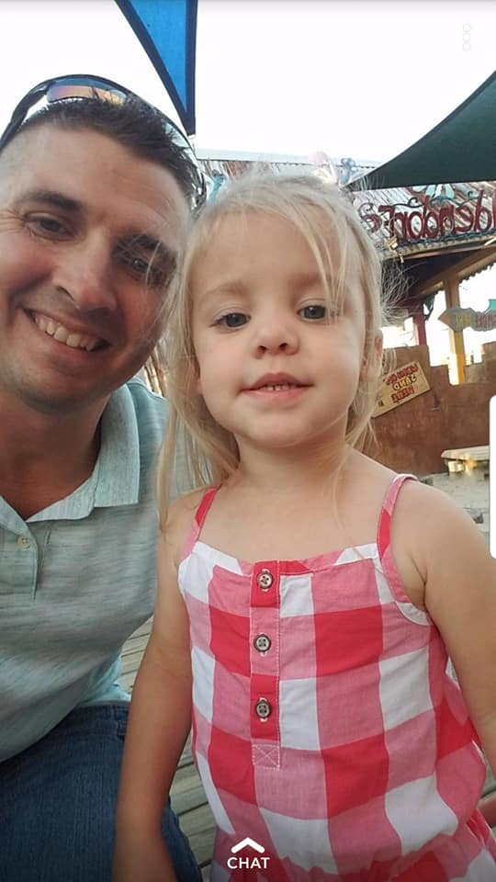

Slide 5
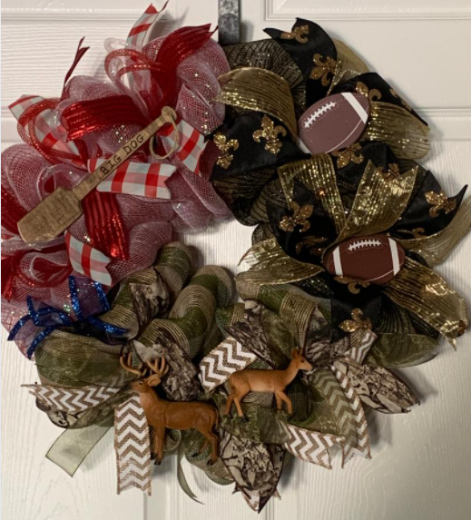
HONORARY Chris “Big Dog” Oliver
Liver recipient
7/20/2021
Chris carried George’s liver for 14 months

Slide 6
HONORARY Lisa Howard Wallace
HONORARY Karen Stewart
Kidney recipients
Diagnosed with PKD (Polycystic Kidney Disease)

Slide 7
2023 Wall of Fallen Heroes
29 - First Responders
15 – Law Enforcement
10 – Fire Fighter
1 – EMT
1 – Military
2 – K9 / Horse

Slide 8
Carl Douglas Kimball
1/12/2023
St. Francisville Police Dept.
COVID

Slide 9
Fire Inspector Taylor E. Bass
2/23/2023
St. Tammany Fire Department District 1
Cardiac Arrest

Slide 10
Lt. William “Billy” Narretto
2/27/2023
Tangipahoa Parish Sheriff’s Office

Slide 11
Cpl. Scotty Canezaro
3/26/2023
Baton Rouge Police Dept.
Aircraft Accident

Slide 12
Sgt. David Poirrier
3/26/2023
Baton Rouge Police Dept.
Aircraft Accident

Slide 13
Detective Sgt. Nicholas Pepper
4/2/2023
Lafourche Parish Sheriff’s Office
Vehicular Assault

Slide 14
Senior Police Office Trevor Abney
4/9/2023
New Orleans Police Dept.
Gunfire

Slide 15
Deputy LaTusha Trusty
5/8/2023
Rapides Parish Sheriff’s Office
Medical Emergency

Slide 16
Capt. Ronald Bourque Sr.
5/25/2023
Chitimacha Police Dept.
Jeanerette Police Dept.

Slide 17
District Chief Jimmy Schexnayder
5/27/2023
Jefferson Parish Fire Dept.
Cancer

Slide 18
Cpl. Shawn Kelly
06/02/2023
Denham Springs Police Dept.
Gunfire

Slide 19
Chief Joseph William Thompson
06/02/2023
Denham Springs Police Dept.
Gunfire

Slide 20
Wayne Husser
06/10/2023
Loranger Volunteer Fire Dept.

Slide 21
Kymber Nichole Nezat
06/27/2023
EMT: Acadian
Vehicle Accident

Slide 22
Deputy Marshal Barry Giglio
07/31/2023
Ville Platte City Marshal’s Office
Gunfire

Slide 23
Pvt. Shad Edward Sheffie
08/04/2023
U. S. Army
Drowning

Slide 24
Lt. Beau Hunter Bowman
08/08/2023
Rayburn Correctional Center
Motorcycle Accident

Slide 25
Capt. Phillip P. Paternostro
08/21/2023
Baton Rouge Fire Dept.
Cancer

Slide 26
Chief Thomas Maury
08/22/2023
Naval Air Station Joint Reserve Base New Orleans Fire and Emergency Services
Cancer

Slide 27
Superintendent Chief Dennis Crocker
09/03/2023
Tangipahoa Parish Fire Protection
Cancer

Slide 28
Tommy Davidson
09/13/2023
Tangipahoa Parish Sheriff’s Dept.
Parkinson’s Disease

Slide 29
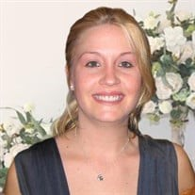
Deputy Mary Mayo
09/21/2023
St. Tammany Parish Sheriff’s Office
Complications from on-duty car crash

Slide 30
Mark D. Beaulieu
10/11/2023
New Orleans Fire Dept.
Cancer

Slide 31
Deputy Robert Weber
10/22/2023
Livingston Parish Sheriff’s Office
Cancer

Slide 32
Capt. William “CJ” Sanders
11/05/2023
Baton Rouge Fire Dept.
Cancer

Slide 33
Joe Winters
12/15/2023
Retired from Kentwood Police Dept.

Slide 34
Capt. Glen D. Wallace
12/27/2023
New Orleans Fire Dept.
Cardiac Arrest

Slide 35
Mounted Deputy Shooter
06/16/2023
Tangipahoa Parish Sheriff’s Office

Slide 36
K9 – Harrie
06/24/2023
Shreveport Police Dept.
Heatstroke

Slide 37
2024 Fallen
Law Enforcement
Deputy Gregory Mitchell EOW 01/31/24
LSP Lt. Amanda Fournier EOW 02/07/24
Capt. Brealon Yelverton EOW 02/20/24
Sheriff Blaise Smith EOW 02/24/24
LSP Lt. Carl Malcolm Bennett Jr. EOW 03/29/24
Deputy Rebecca Gibson EOW
Officer Russell Croxton EOW 04/27/24
La. Wildlife & Fisheries
Colonel Winton Joseph Vidrine EOW 03/02/24
Agent Zachary Funderburk EOW 03/22/24
Firefighter
Chief Danny Richardson EOW 02/03/24
Joseph J. Ayo EOW 05/07/24
Military
Private First Class Austin Lilley EOW 01/27/24
TSgt. Andrew Bingham EOW 04/13/24

Slide 38
In memory of our fallen first responders

