Slide 2
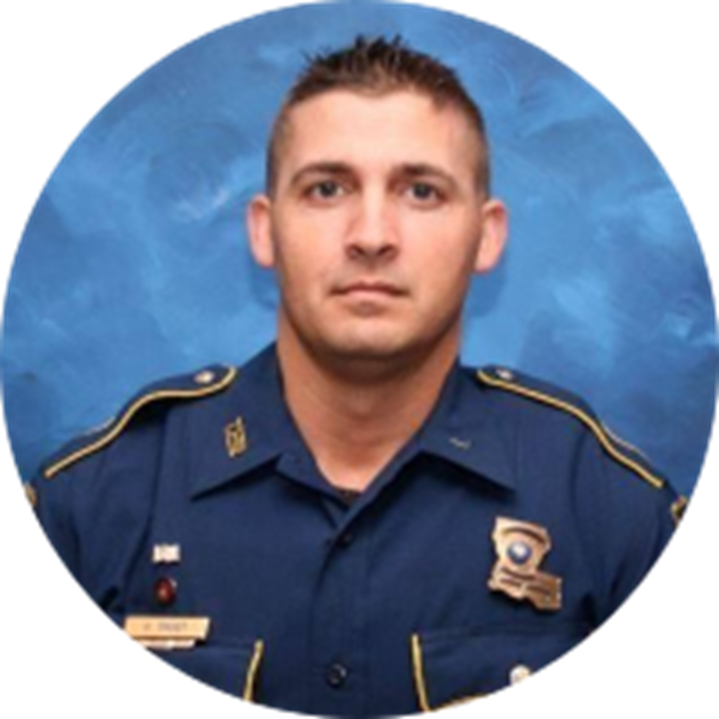
Why was L36 A Warrior’s
Way established?
LA State Trooper George B. Baker
EOW 5/24/2020
Call number: L36
A warrior in everything he did!

Slide 3
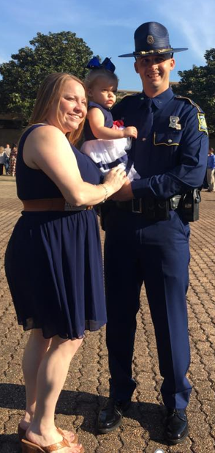
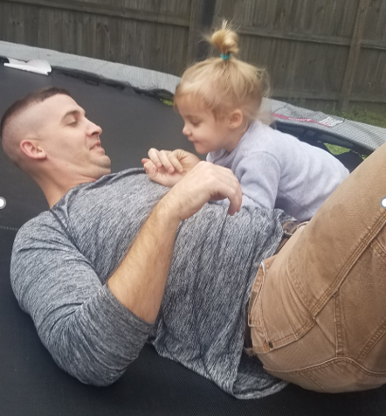
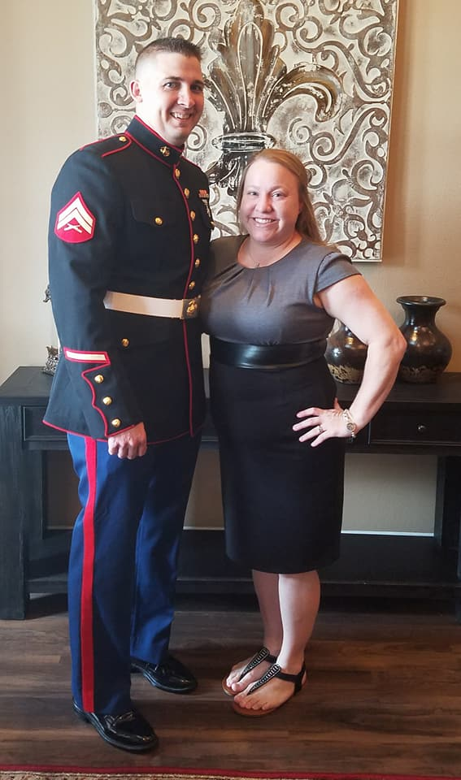
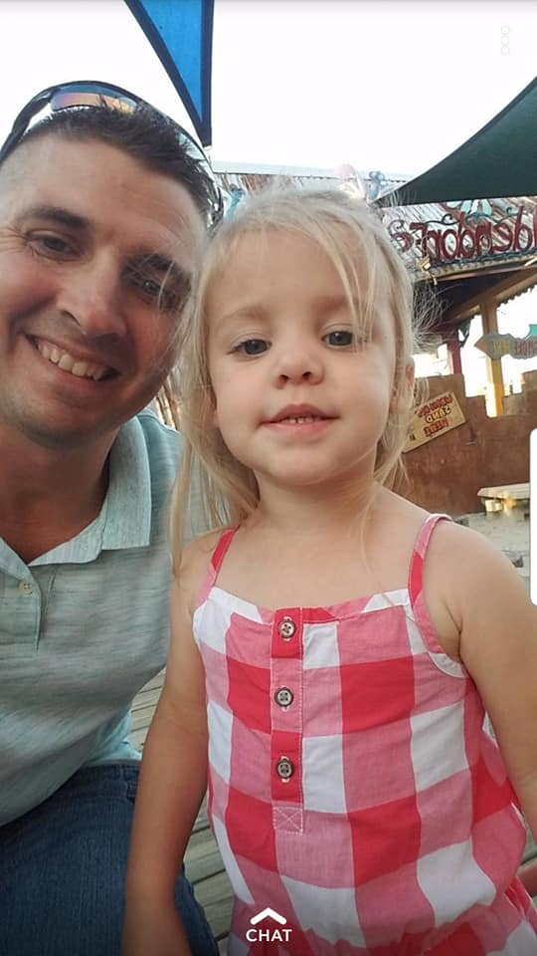
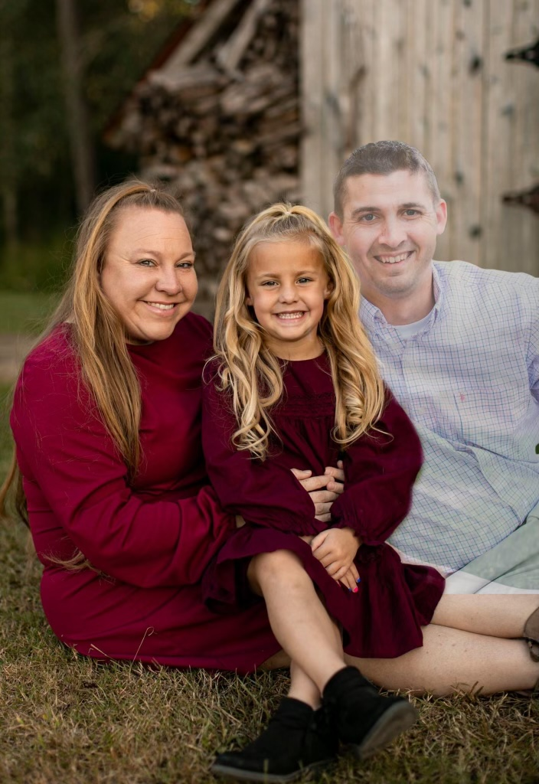
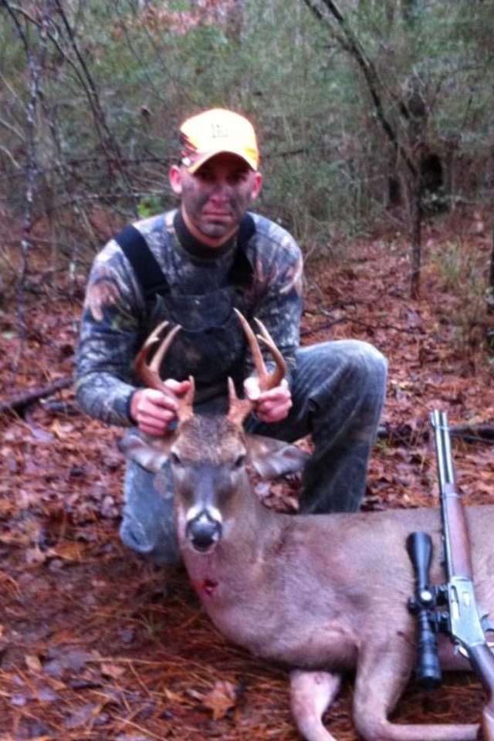
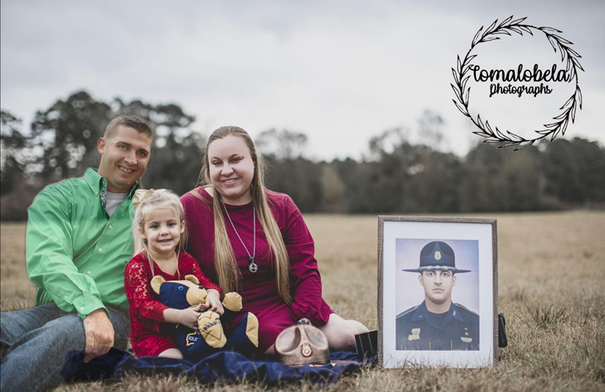

Slide 5
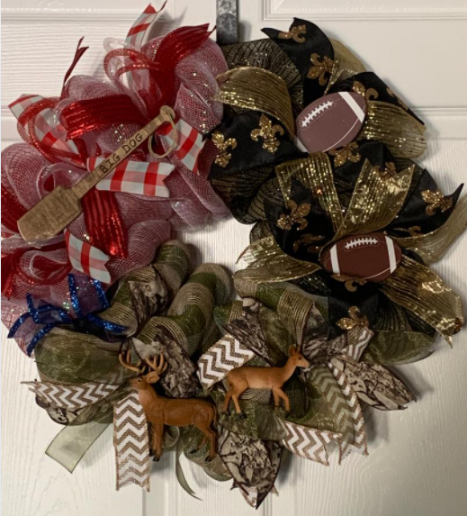
HONORARY Chris “Big Dog” Oliver EOW 7/20/2021
Liver recipient
Chris carried George’s liver for 14 months

Slide 6
HONORARY Lisa Howard Wallace
HONORARY Karen Stewart
Kidney recipients
Diagnosed with PKD (Polycystic Kidney Disease)
Kidney Recipient

Slide 7
2022 Wall of Fallen Heroes
16 First Responders
6 – Law Enforcement
6 – Fire Fighter
0 – Military
3 – K9
1 - Other

Slide 8
Logan Copeland 2/24/2022
Dequincy Fire Dept.
Car crash

Slide 9
Karrington Len Jade Smith and baby Dallas 3/12/2022
Pine Grove Fire Dept.
Gunshot

Slide 10
Sgt. Nicholas Tullier 5/5/2022
EBR Sheriff’s Office
Gunshot

Slide 11
Alex Bourque 5/21/2022
Lafayette Fire Dept.
Broussard Fire Dept.
Cancer

Slide 12
Carroll Philip Poche III 5/21/2022
St. Tammany Parish District 9 Fire

Slide 13
Alec “Mugs” J. Mulvihill 6/12/2022
New Orleans Fire Dept.

Slide 14
Lt. Jerome Hookfin 7/6/2022
St. Helena Parish Sheriff’s Office

Slide 15
Brian Olliff 7/17/2022
Natchitoches Police Dept.
Heat-related

Slide 16
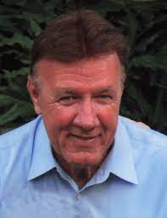
Darrell Guillory 11/20/2022
DOTD
Retired BRPD
Stabbing

Slide 17
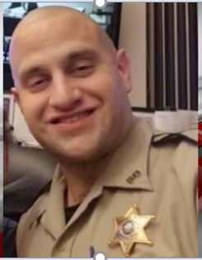
Deputy Myles Ledet 12/4/2022
Tangipahoa Parish Sheriff’s Dept.

Slide 18
Capt. Walker L. Hill 12/17/2022
Baton Rouge Fire Dept.
Medical emergency

Slide 19
City Marshal Mike Zito 12/19/2022
Port Allen City Marshal

Slide 20
Deputy Adam Nelson 12/29/2022
Sabine Parish Sheriff’s Office
Accident while on vacation

Slide 21
K-9 Senda 4/6/2022
LA State Police (retired)
Natural Causes

Slide 22
K-9 Kano 8/11/2022
Slidell Police Dept.
Spleen Cancer

Slide 23
K-9 Scout 8/28/2022
Slidell Police Dept. (retired)
Health issues

Slide 24
In memory of our fallen first responders

