Slide 2
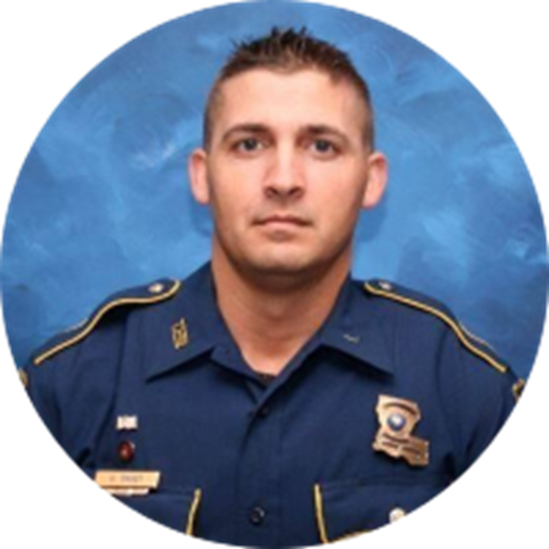
Why was L36 A Warrior’s
Way established?
LA State Trooper George B. Baker
EOW 5/24/2020
Call number: L36
A warrior in everything he did!

Slide 3
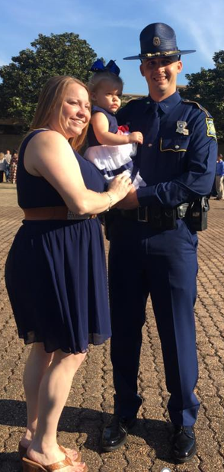
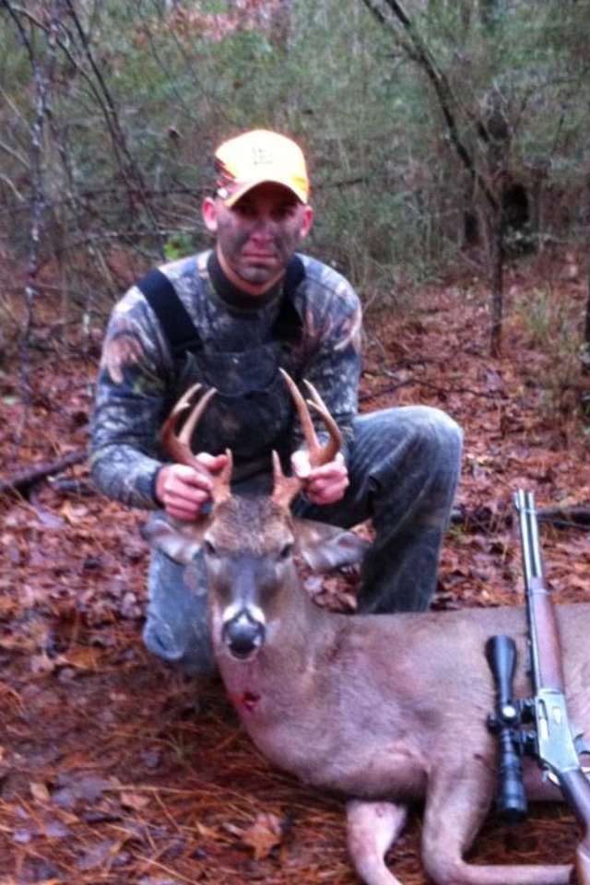
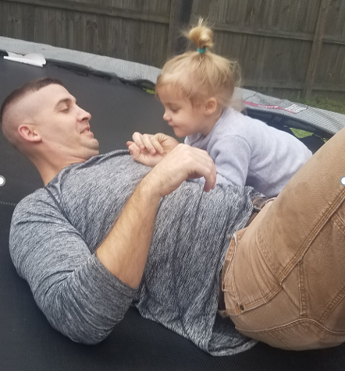
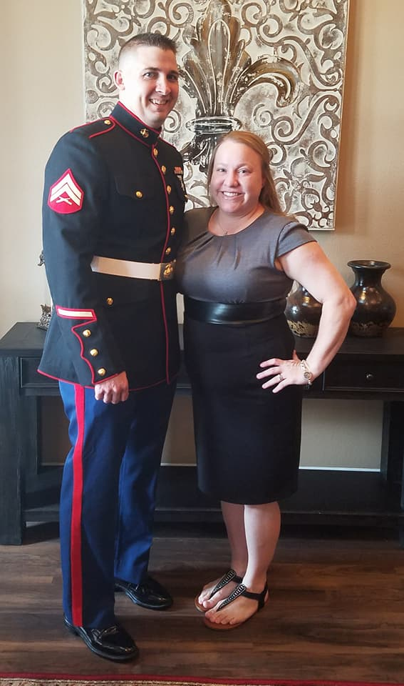
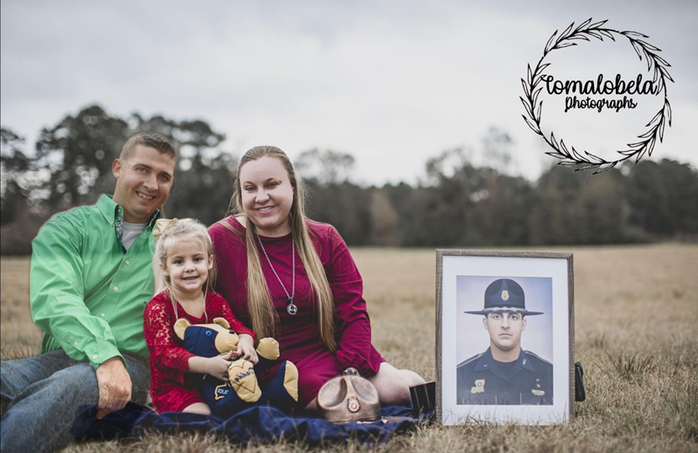
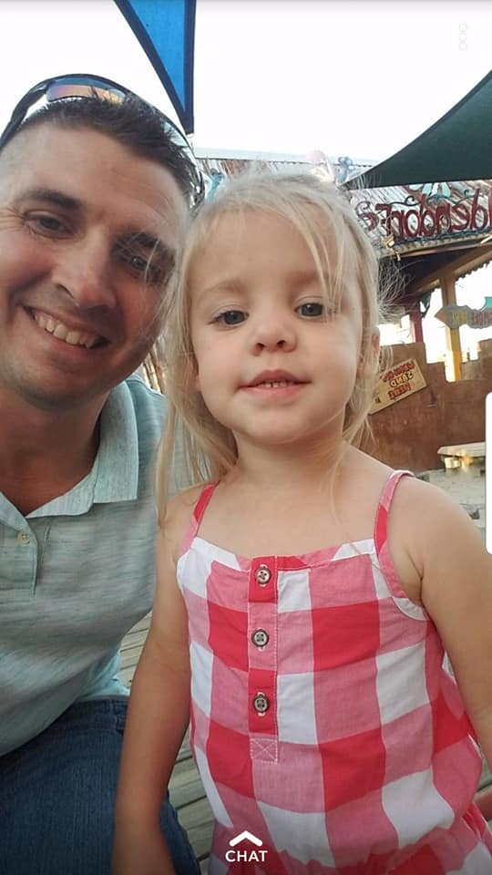

Slide 5
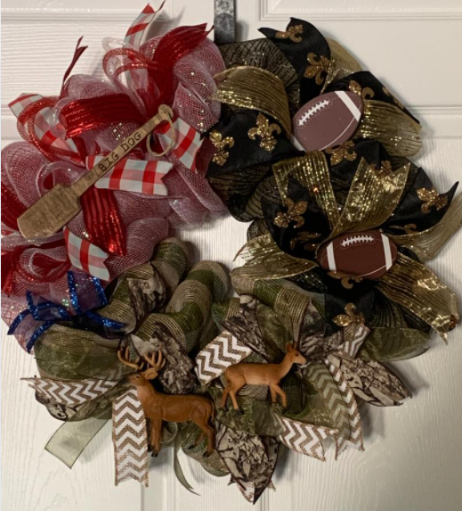
HONORARY Chris “Big Dog” Oliver EOW 7/20/2021
Liver recipient
Chris carried George’s liver for 14 months

Slide 6
HONORARY Lisa Howard Wallace
HONORARY Karen Stewart
Kidney recipients
Diagnosed with PKD (Polycystic Kidney Disease)
Kidney Recipient

Slide 7
2021 Wall of Fallen Heroes
33 First Responders
23 – Law Enforcement
7 – Fire Fighter
2 – Military
1 – K9

Slide 8
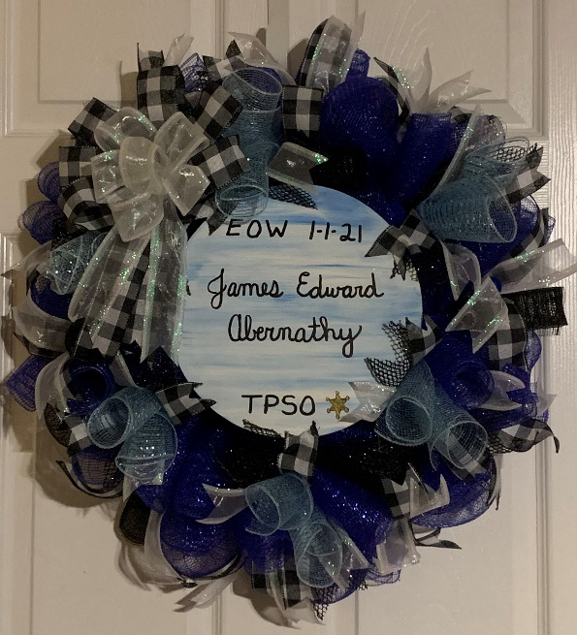
James Edward Abernathy 1/1/2021
Tangipahoa Parish Sheriff’s Officer
COVID related
No Photo Available

Slide 9
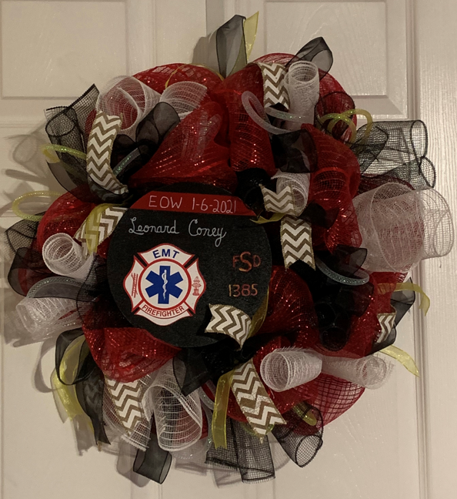
Leonard Coney EOW 1/6/2021
Shreveport Fire Dept.
Medic 5
Traced COVID related

Slide 10
Sgt. Charles Dotson 1/25/2021
Baton Rouge Police Department
Traced COVID related

Slide 11
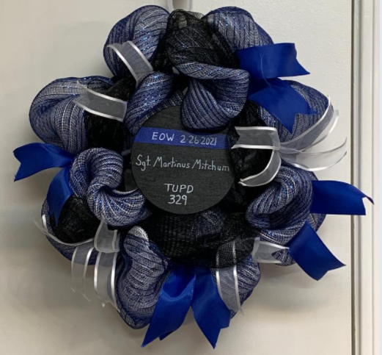
Sgt. Martinus Mitchum EOW2/26/2021
Tulane Univ. Police Dept.
Reserve Deputy Constable at 2nd City Court
Gunshot

Slide 12
Christopher Shane Simpkins 4/12/2021
U.S. Border Patrol
COVID

Slide 13
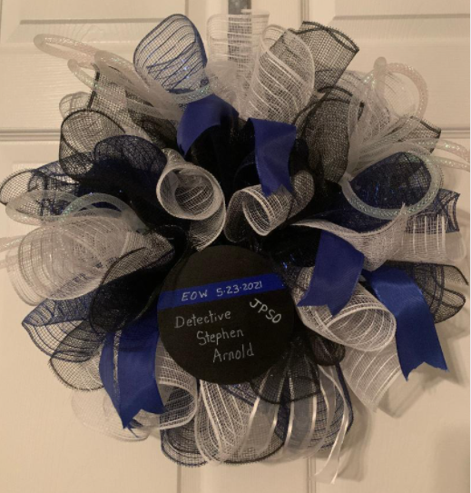
Detective Stephen Arnold EOW 5/23/2021
Jefferson Parish Sheriff’s Office
Gun shots sustained on 1/26/16
Remained in a coma until 5/23/21

Slide 14
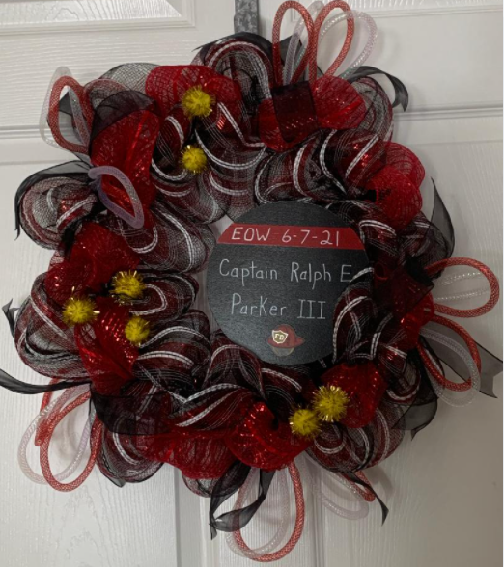
Captain Ralph E. Parker III EOW 6/7/2021
Shreveport Fire Dept.
Cancer

Slide 15
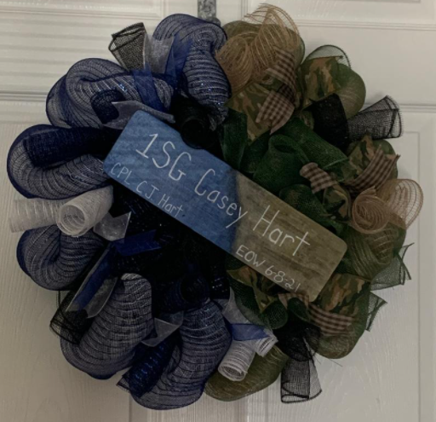
1SG Casey J. Hart EOW 6/8/2021
LA Army National Guard
Baton Rouge Police Dept
Non-combat injury

Slide 16
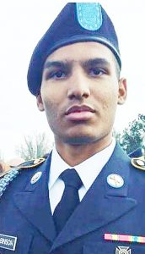
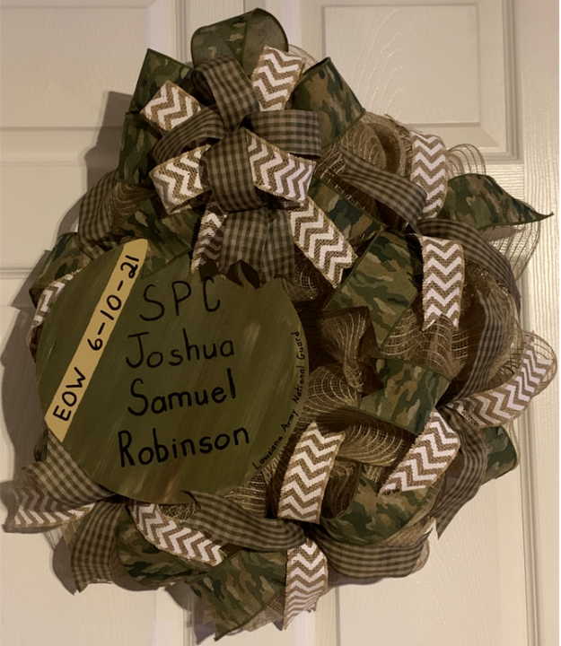
SPC Joshua Samuel Robinson 6/10/2021
Army National Guard
Non-combat injury

Slide 17
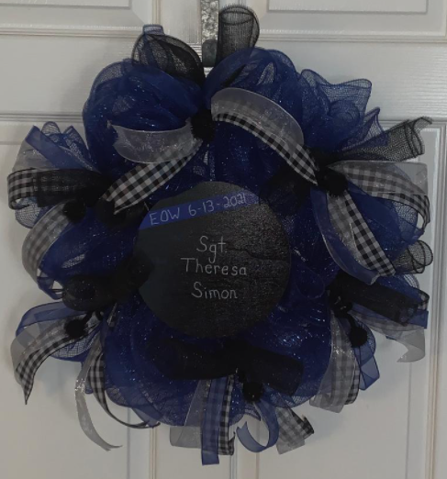
Sgt. Theresa E. Simon EOW 6/13/2021
Slidell Police Dept.
Heart Attack

Slide 18
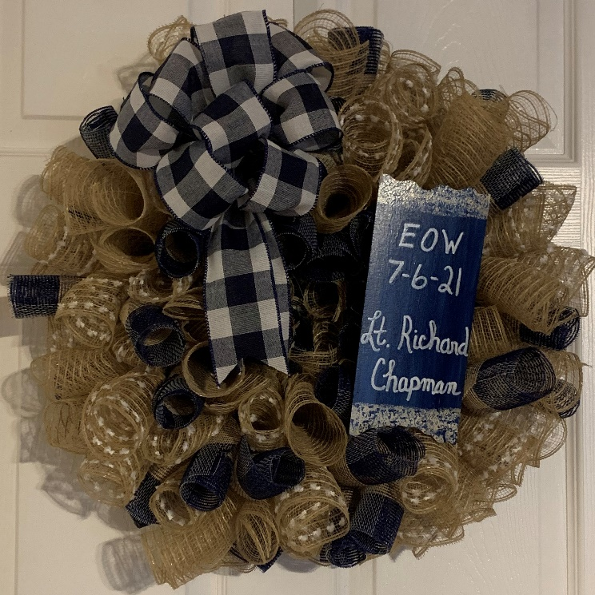
Lt. Richard Chapman EOW 7/6/2021
Tangipahoa Parish
Sheriff’s Office

Slide 19
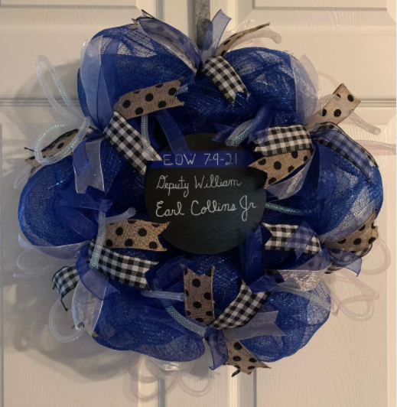
William Earl Collins Jr. EOW 7/9/2021
Doyline Police Dept.
Correctional Supervisor with
Webster Parish Sheriff’s Office
Gunshot

Slide 20
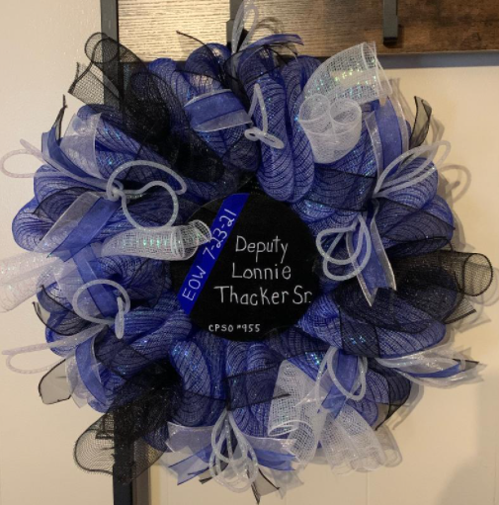
Lonnie L. Thacker Sr. EOW 7/23/2021
Caddo Parish Auxiliary Deputy
Car crash

Slide 21
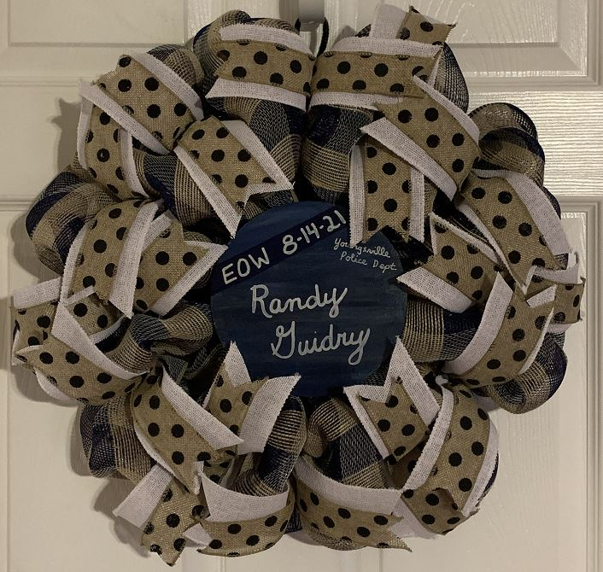
Randy Guidry 7/30/2021
Youngsville Police Dept.
COVID related

Slide 22
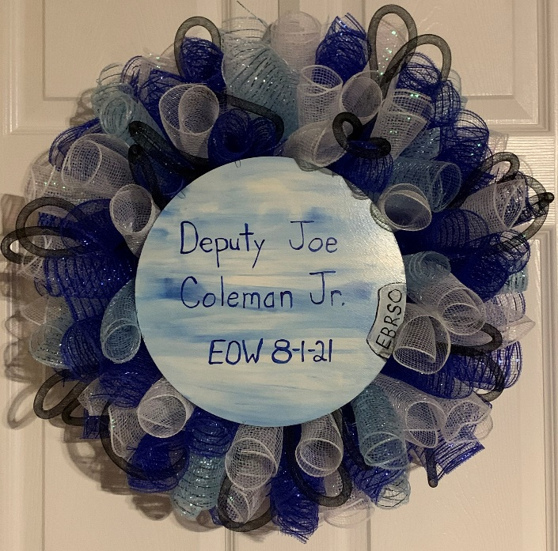
Deputy Joe M. Coleman Jr. 8/1/2021
East Baton Rouge Parish Sheriff’s Office
COVID related

Slide 23
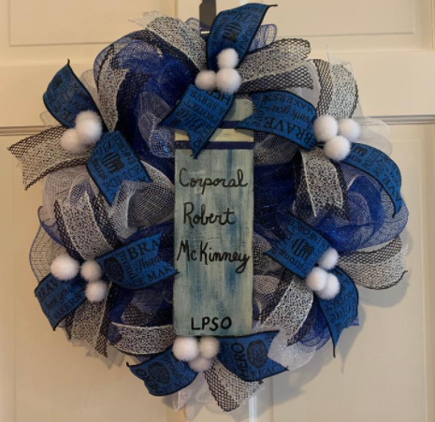
Corporal Robert McKinney 8/5/2021
Livingston Parish Sheriff’s Office
Traced COVID related

Slide 24
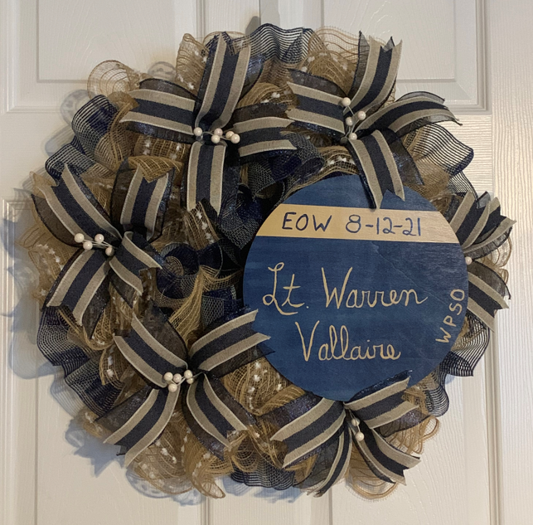
Lt. Warren Vallaire 8/12/2021
Washington Parish Sheriff’s Office
COVID related

Slide 25
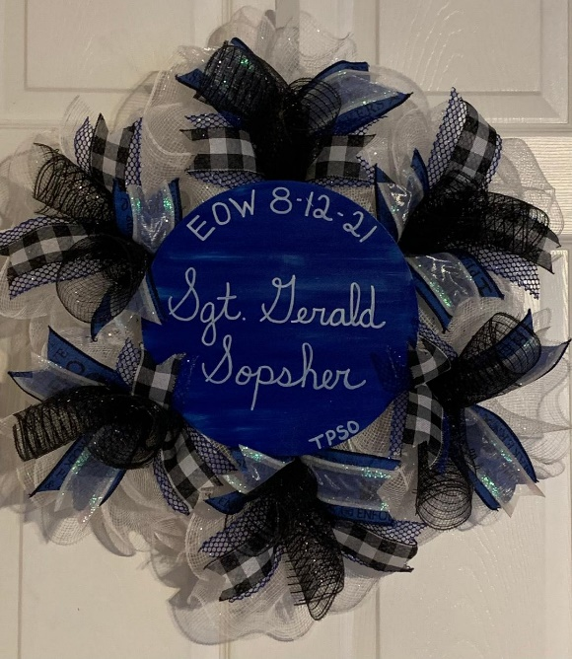
Sgt. Gerald Sopsher 8/12/2021
Tangipahoa Parish Sheriff’s Office
COVID related

Slide 26
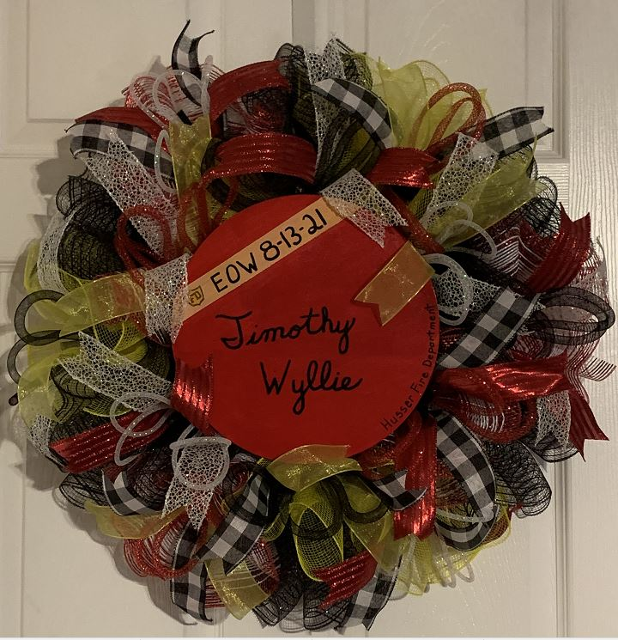
Timothy Wyllie 8/13/2021
Husser Fire Dept.
COVID related

Slide 27
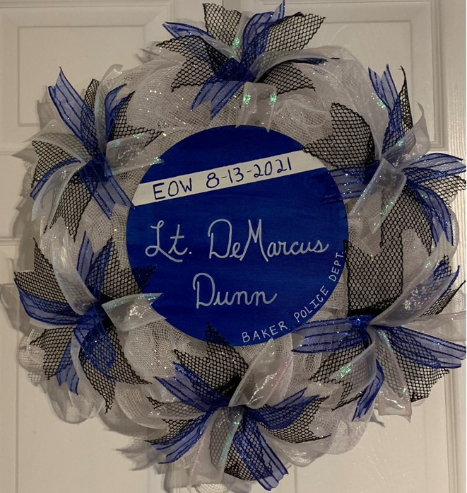
Demarcus Dunn 8/13/2021
Baker Police Dept.
COVID related

Slide 28
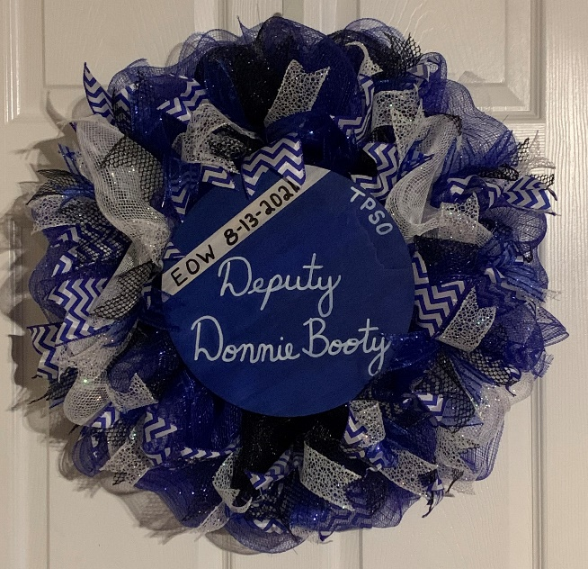
Donnie Booty Sr. 8/13/2021
Tangipahoa Parish Sheriff’s Office
COVID related

Slide 29
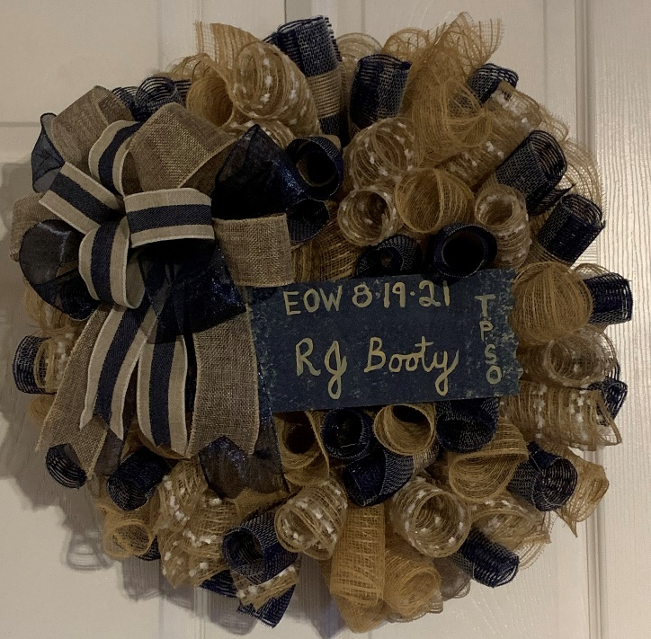
RJ Booty 8/19/2021
Tangipahoa Parish Sheriff’s Office
COVID related

Slide 30
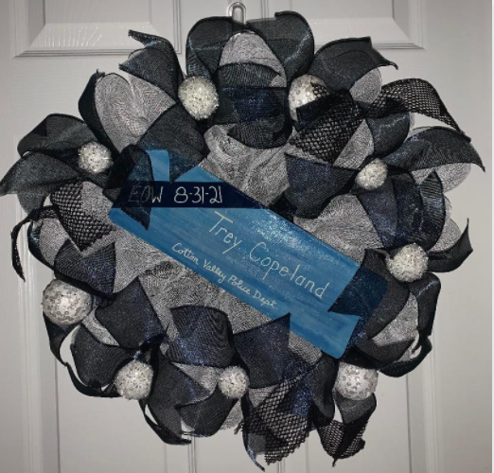
Trey Copeland 8/31/2021
Cotton Valley Police Department
Heart attack

Slide 31
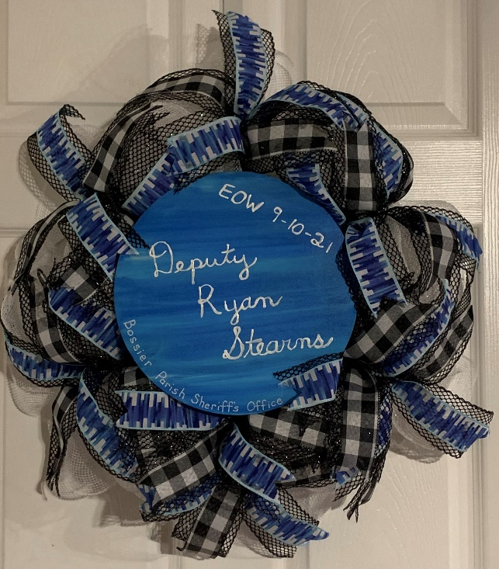
Deputy Ryan Stearns 9/10/2021
Bossier Parish Sheriff’s Office
Diverticulitis

Slide 32
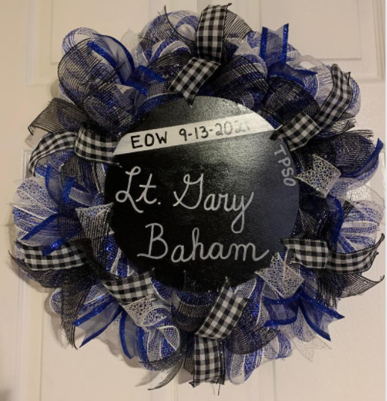
Lt. Gary Baham 9/13/2021
Tangipahoa Parish Sheriff’s Office
Tangipahoa Parish Coroner’s Office

Slide 33
Austin Spencer Bush 9/16/2021
Houma Police Dept.
Drowning

Slide 34
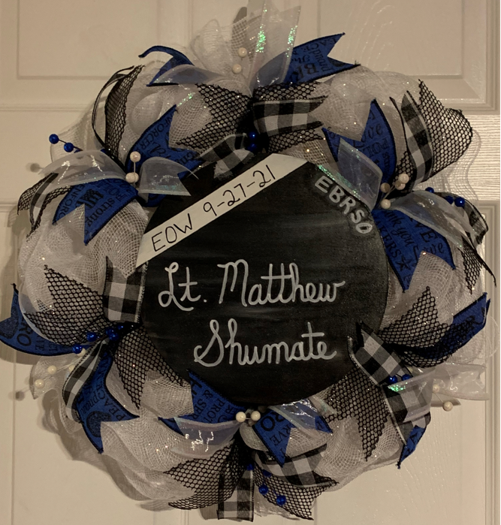
Lt. Matthew Shumate 9/27/2021
East Baton Rouge Parish Sheriff’s Office
COVID related

Slide 35
Chief Donald Ray Scafidel 10/07/2021
Natalbany Volunteer Fire Department

Slide 36
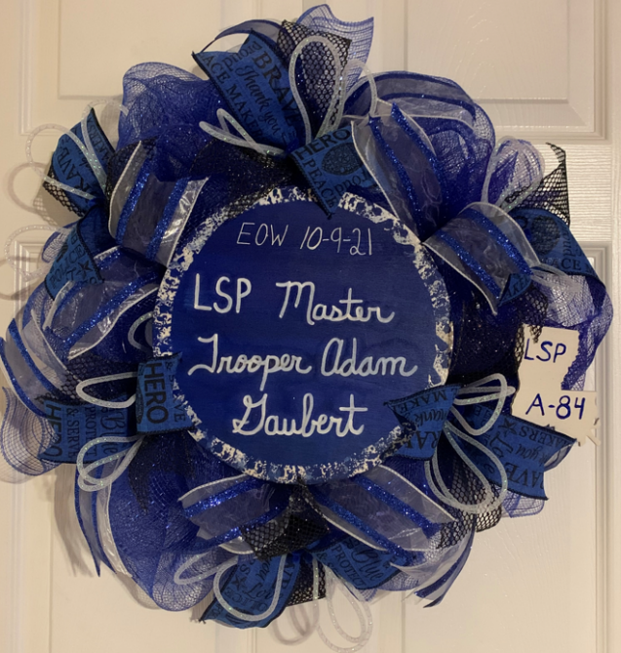
Master Trooper Adam Gaubert 10/9/2021
La. State Police
Gunshot

Slide 37
Leo Schultz 10/10/2021
Harahan Fire Dept.

Slide 38
Chief Keith Sonnier 10/11/2021
Lafayette Fire Dept.

Slide 39
Jessie Henry 12/18/2021
South Bossier Parish Fire District 2
La. Army National Guard
Tire explosion

Slide 40
K-9 IVAR 8/20/2021
Livingston Parish Sheriff’s Office
Heatstroke

Slide 41
In memory of our fallen first responders

